Slide 1

Managing the silverleaf whitefly, Bemisia tabaci, and Tomato yellow leaf curl, a geminivirus
Hugh Smith
University of Florida
Gulf Coast Research and Education Center
Wimauma, FL 33598

Slide 2
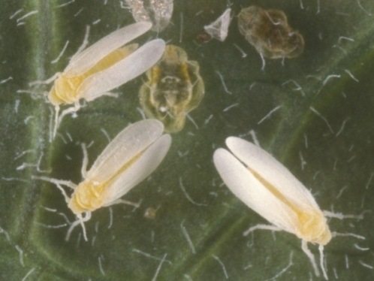
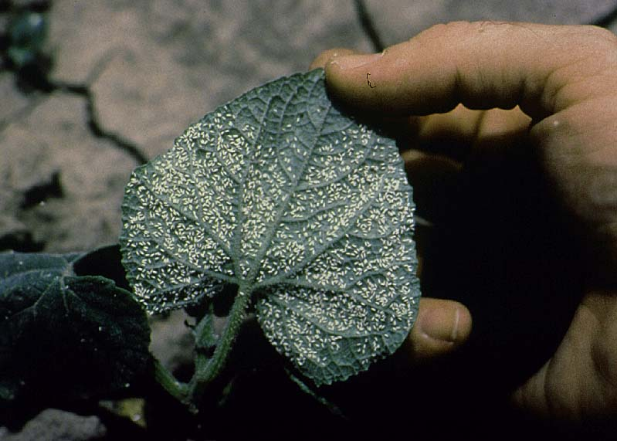
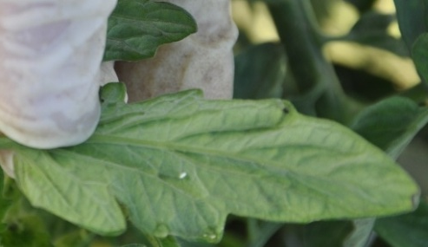
Silverleaf whitefly adult (Bemisia tabaci)

Slide 3
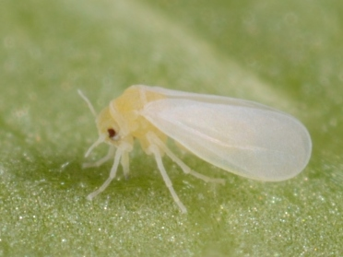
Silverleaf whitefly – piercing sucking mouthpart
Lyle Buss

Slide 4
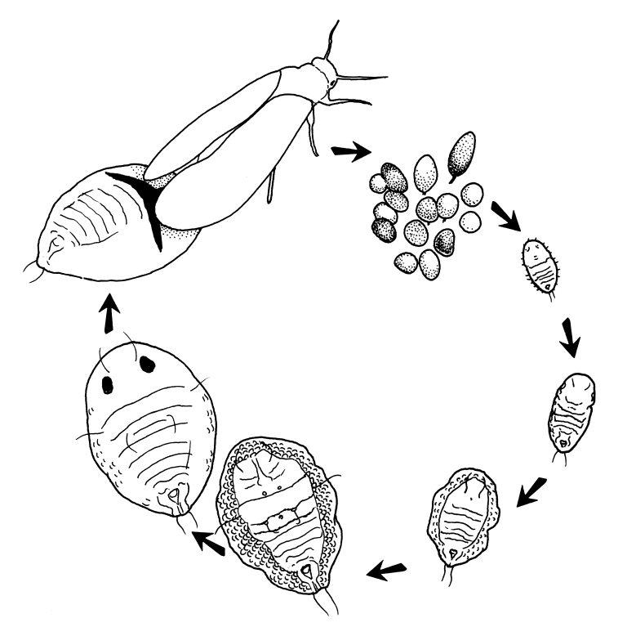
Life cycle of silverleaf whitefly
Adult
Eggs
First instar – “crawler”
Red-eyed nymph: final stage of fourth instar
Second instar
Third instar
Fourth instar
Drawing: Jane Medley

Slide 5
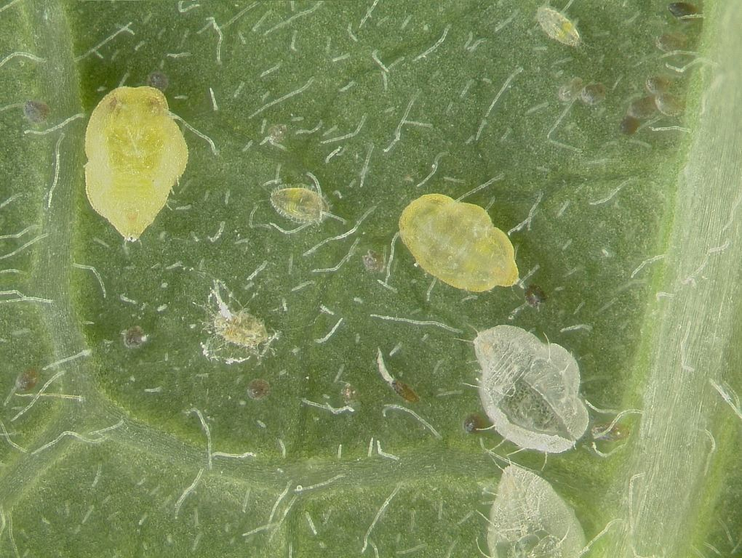
Silverleaf whitefly eggs and nymphs
Lyle Buss

Slide 6
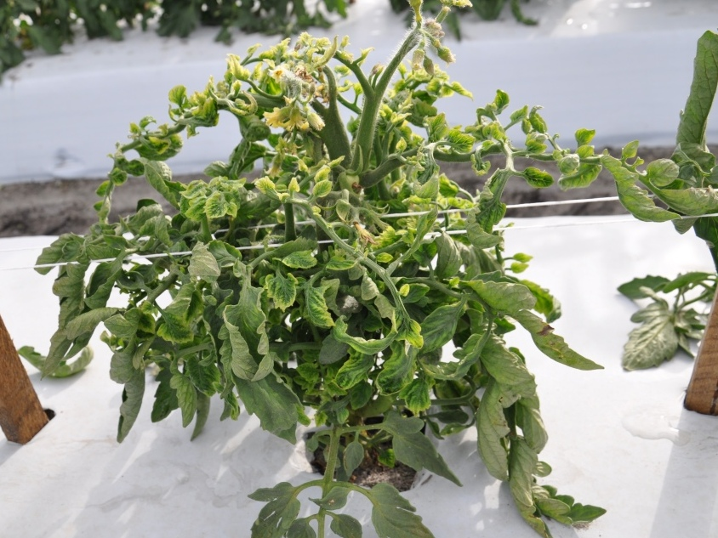
Tomato Yellow Leaf Curl virus – persistently vectored by silverleaf whitefly

Slide 7
Pest Density
Economic Injury Level
Action Threshold
Pest density with control measures applied
Time

Slide 8
Development time for silverleaf whitefly at different temperatures, Yang and Chi 2006
Centi-grade | Fahren-heit | Egg to Adult (days)
15 | 59 | 82
20 | 68 | 49
25 | 77 | 28
28 | 82 | 25
30 | 86 | 22
35 | 95 | 18
Developmental threshold:
11.4 C/53 F.

Slide 9
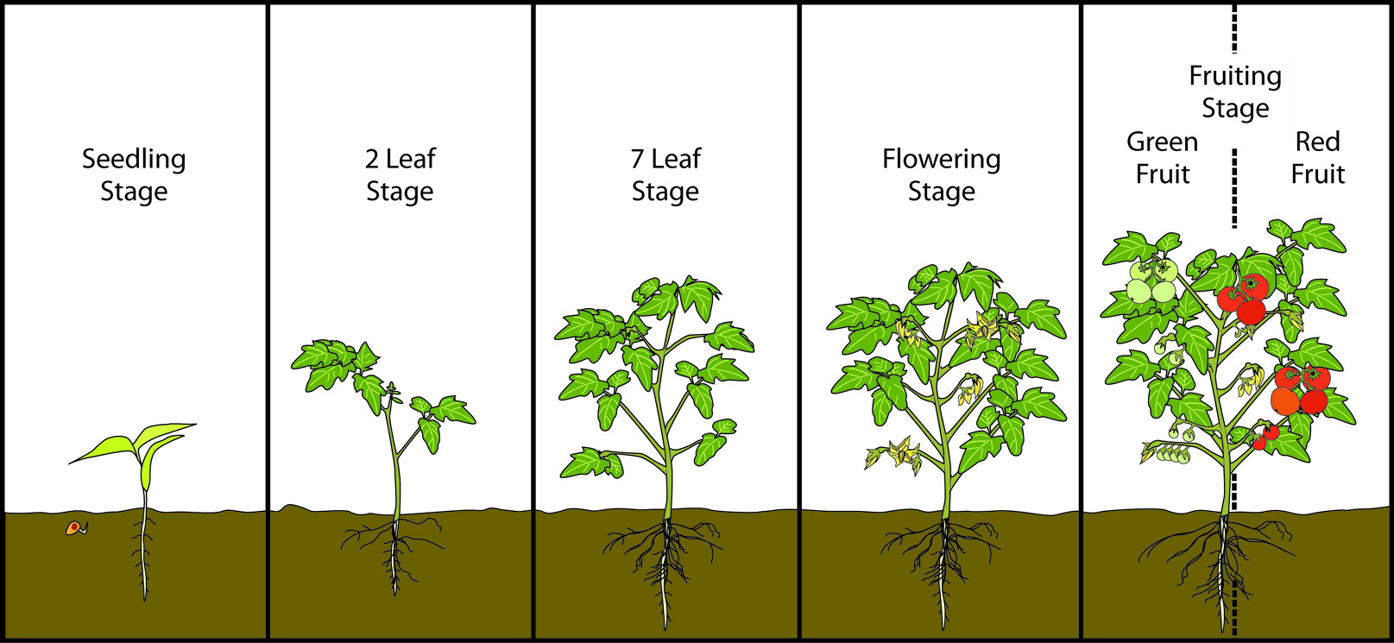
Tomato must be protected from TYLCV during first 5 weeks after transplanting
 | Vegetative | Flowering | Green Fruit | Ripe Fruit
Whiteflies
Mites
Thrips
Leafminers
Armyworms
Loopers
Tomato hornworm
Tomato pinworm
Stinkbugs/leaf-footed bugs

Slide 10
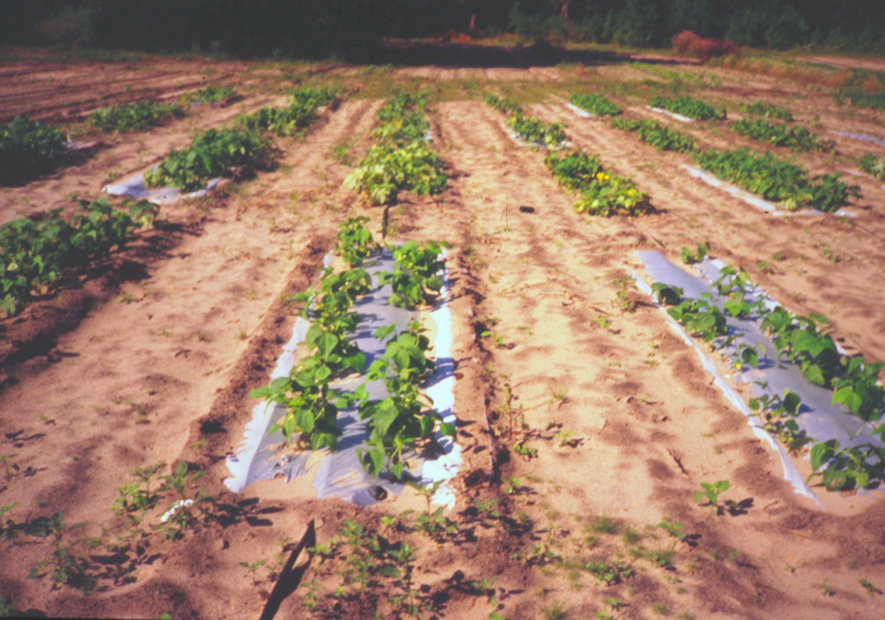
Whiteflies, aphids and thrips are repelled by UV.
UV reflective mulch has been used to reduce insect numbers and virus incidence.
Rosie’s Organic Farm, Gainesville, 1995

Slide 11
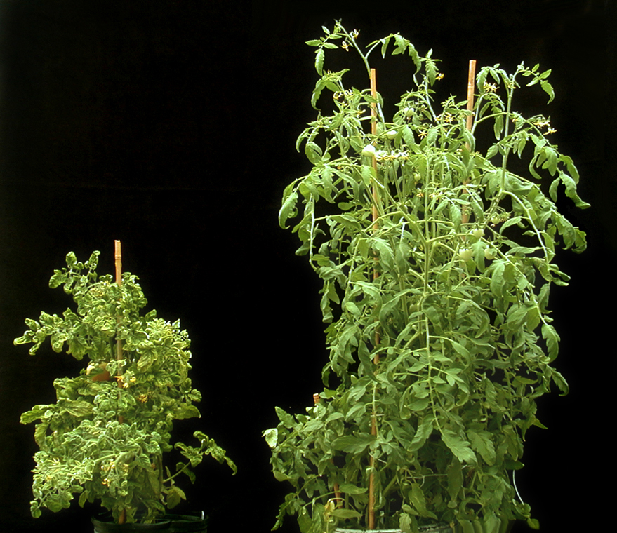
Tomato varieties resistant to TYLCV
▪ Ripening issues
▪ Growers prefer susceptible varieties
▪ Resistant varieties can be sources of TYLCV
Photo: IFAS
TYLCV susceptible TYLCV resistant

Slide 12
Sources of TYLCV
Old Tomato Field
Non-Symptomatic Pepper/Squash Field
Susceptible Tomato Field
Resistant Tomato Field
Grape Tomato/Indeterminate variety

Slide 13
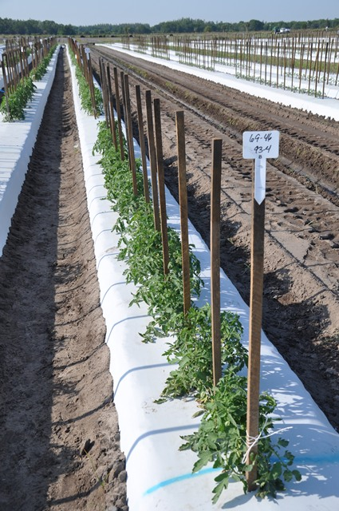
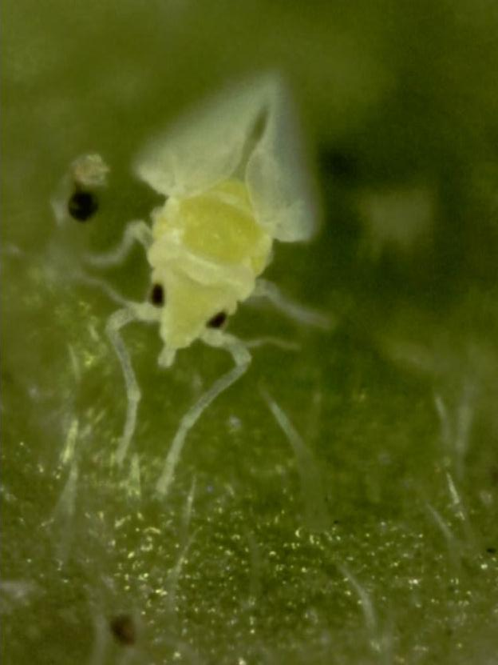
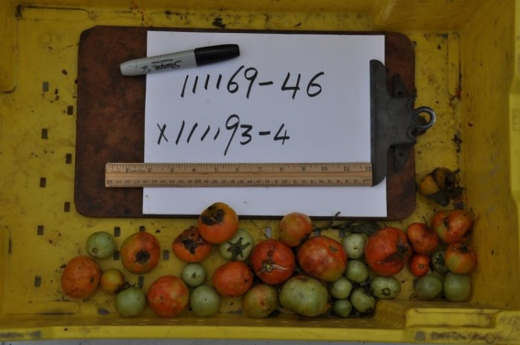
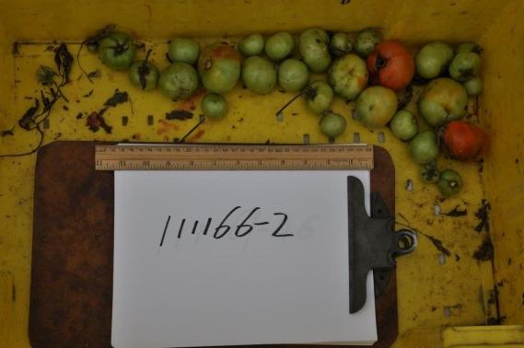
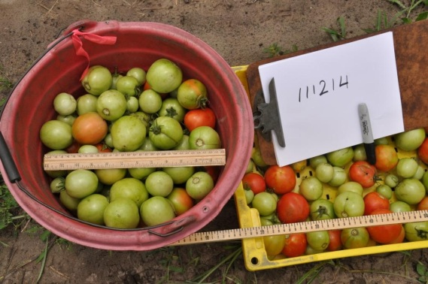
Collaboration with Cornell University tomato breeder Dr. Martha Mutschler: evaluating resistance to TYLCV and B. tabaci
~ acyl sugars (exhudates) and trichomes.

Slide 14
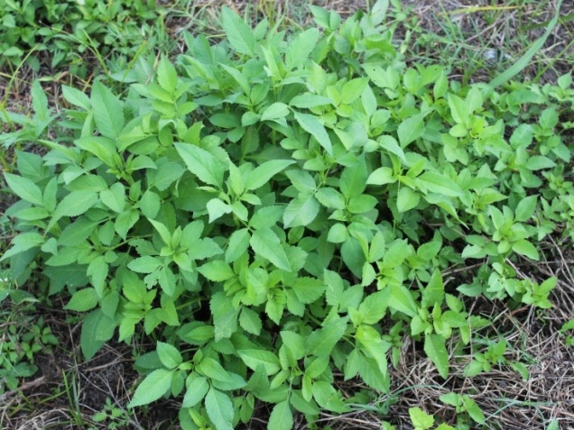
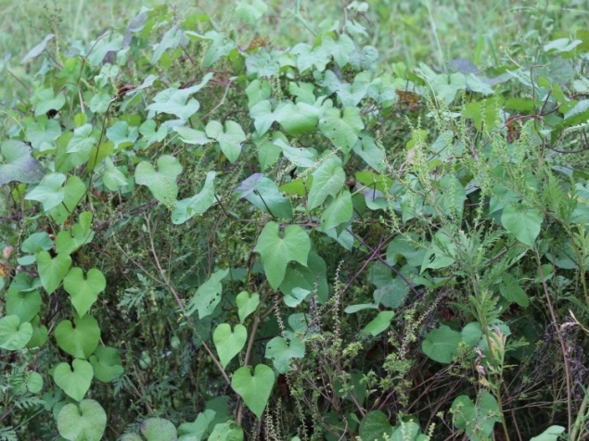
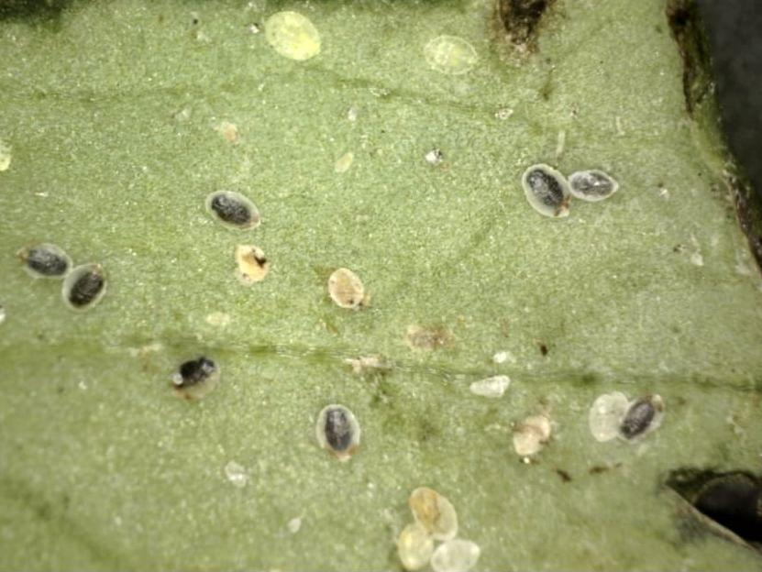
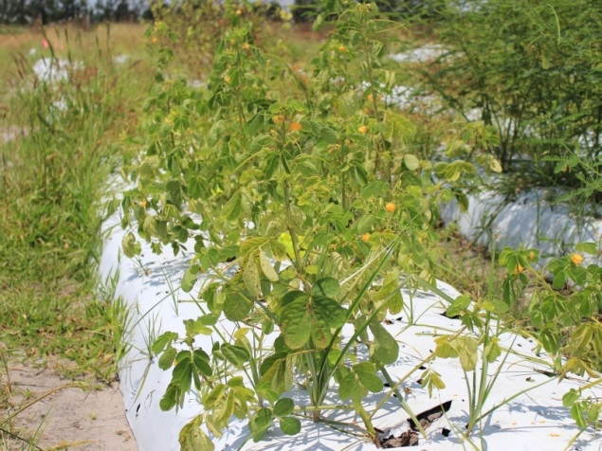
Weeds as hosts of TYLCV?
▪ Confirmed in other countries
▪ Florida testing so far negative
Bidens pilosa
Morning glory
Parasitized (black) whitefly nymphs on sicklepod
Sicklepod

Slide 15
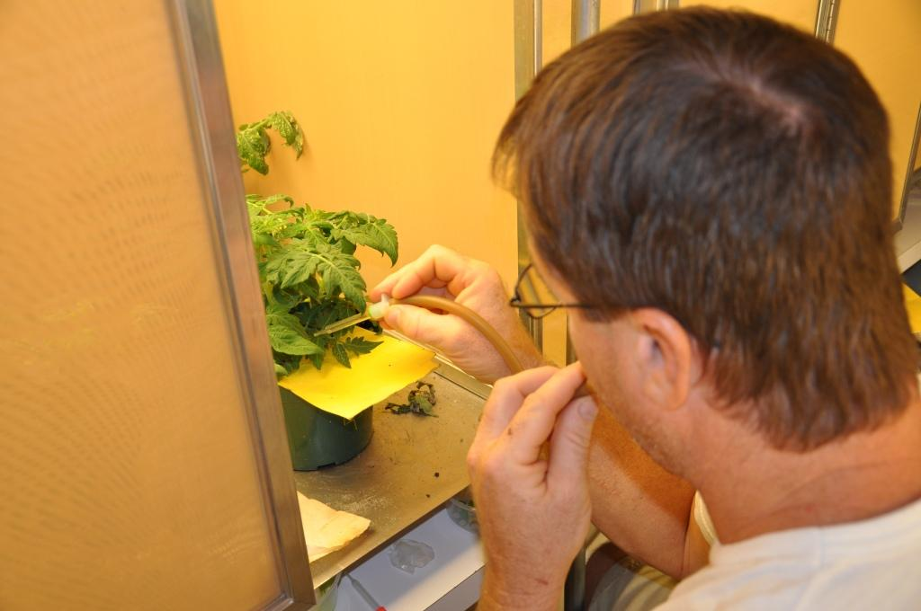
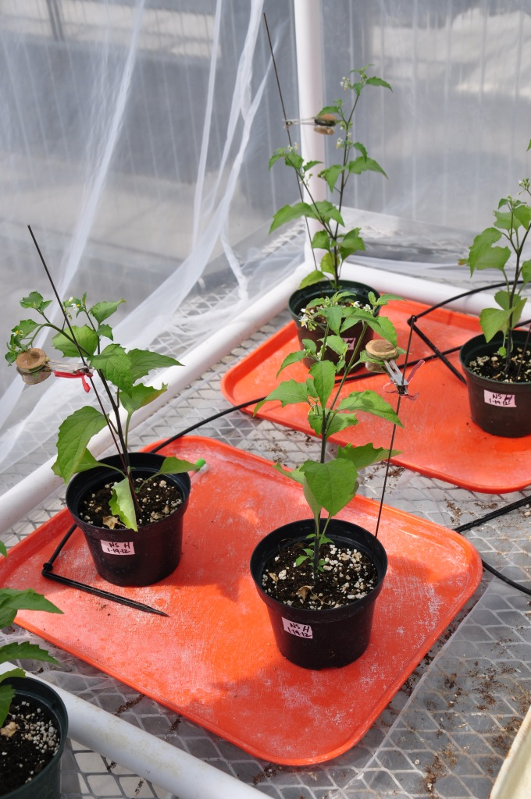
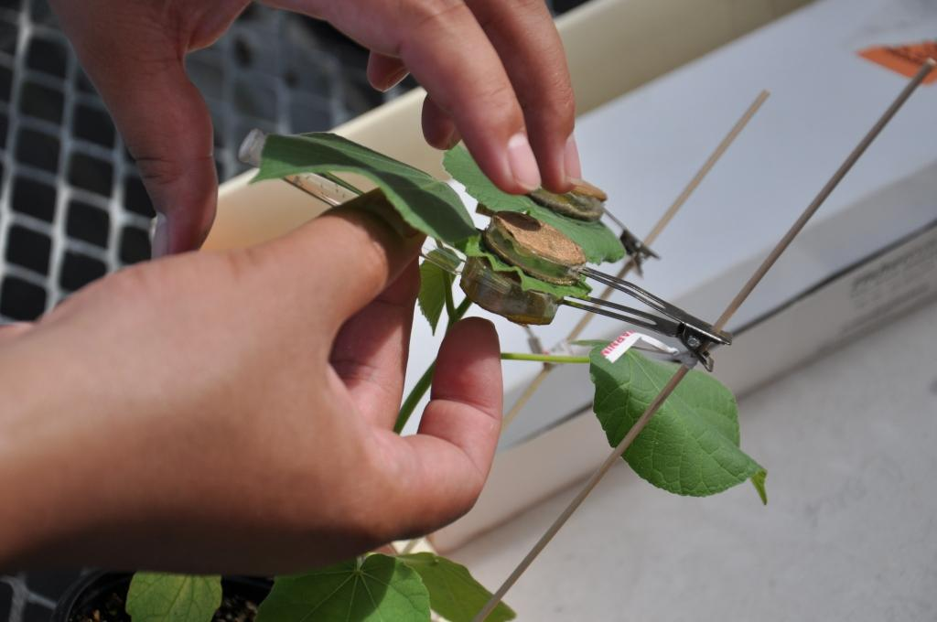
Weeds as hosts of TYLCV
Transmission studies using Koch’s postulates

Slide 16
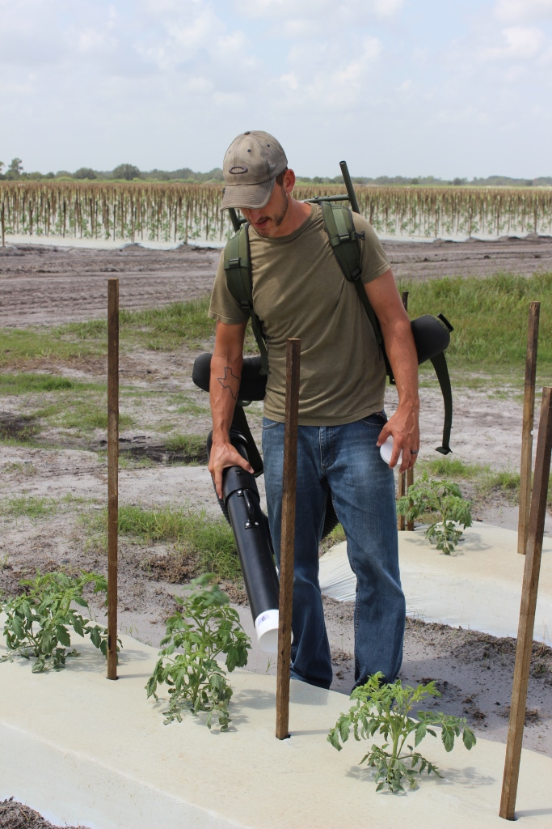
Quantify proportion of adult whiteflies with TYLCV over cropping season
– collected from tomato and weeds on-farm.

Slide 17
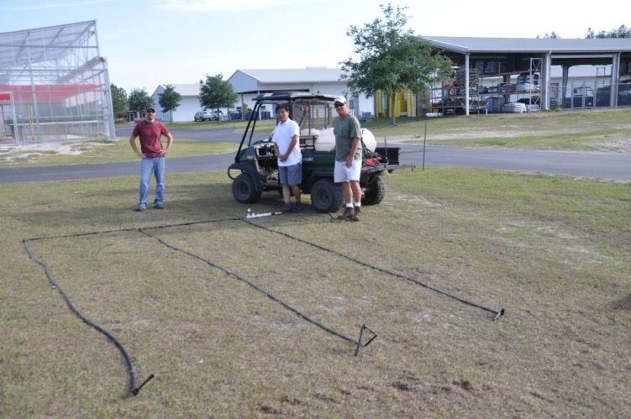
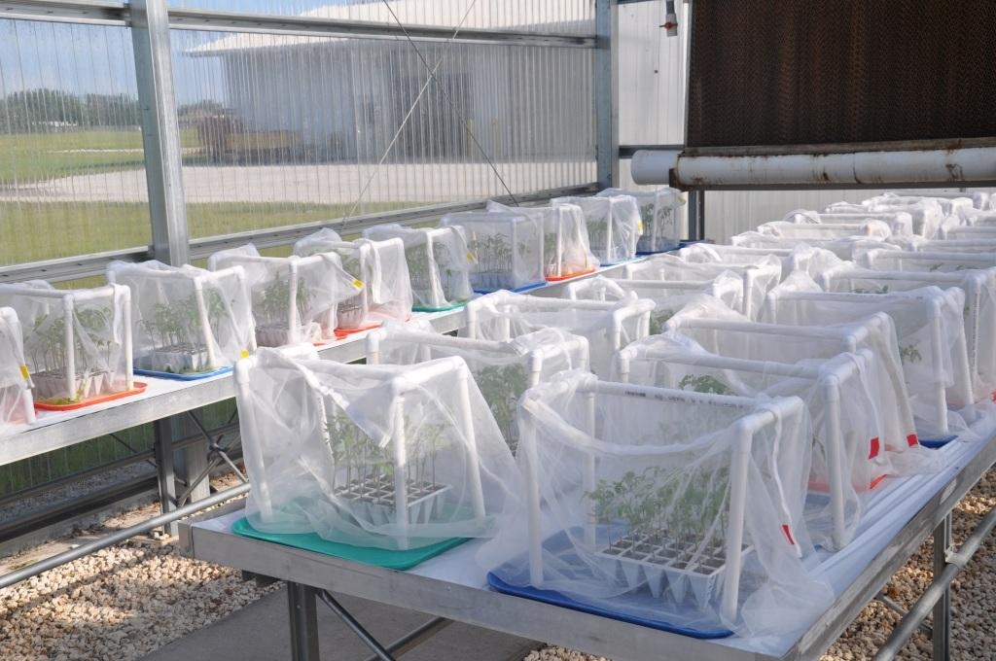
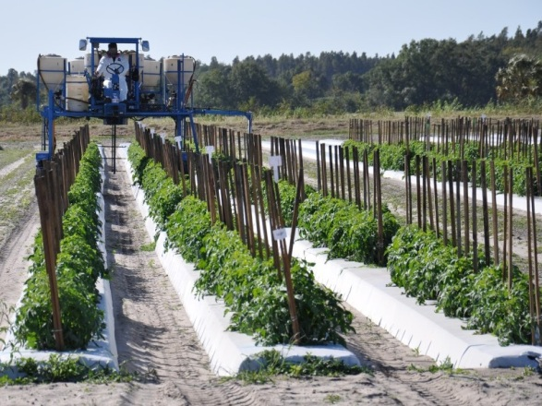
Whitefly Insecticide Trials:
At-Plant, Drip-Injected and Foliar Treatments
Field and Greenhouse Studies
Drip Injection
Greenhouse studies
Foliar treatments

Slide 18
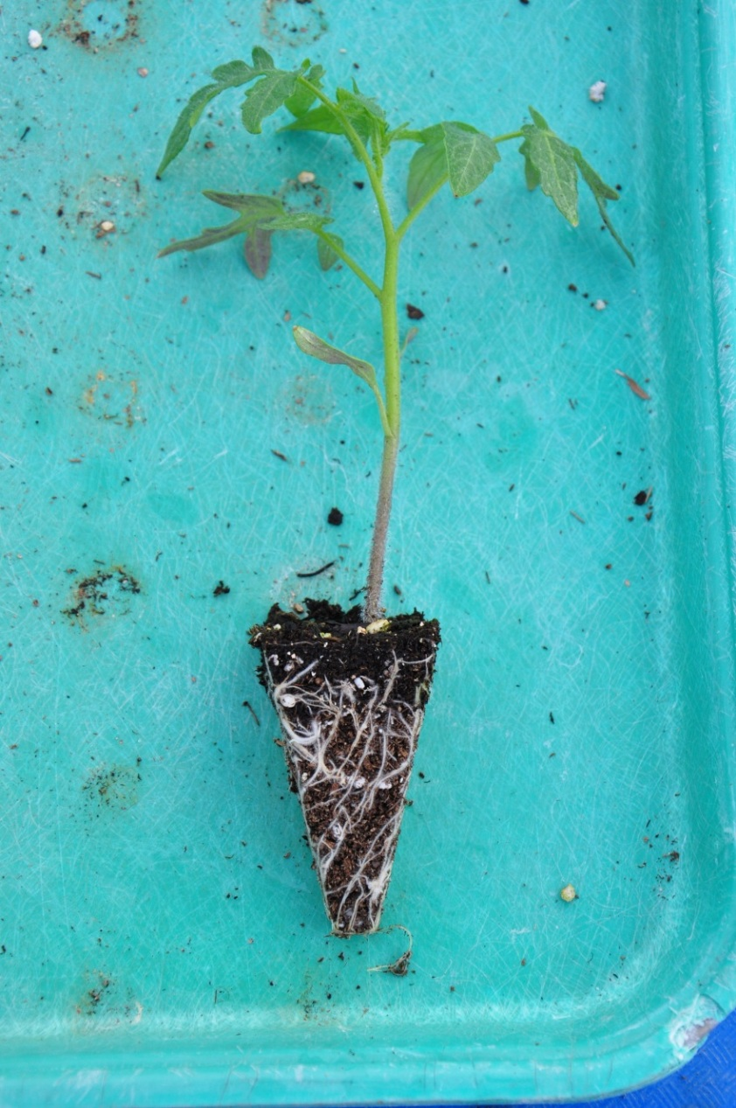
At plant vs drip injected applications:
7-10 days for
complete uptake of
at-plant material
through roots.

Slide 19
Mode of Action:
The mechanism or pathway by which an insecticide kills.
Trend has been from broad spectrum to target-specific modes of action.

Slide 20
Examples and their Mode of Action Numbers:
● Nerve/muscle poisons
Acetylcholinestrase inhibitors
Carbamates – 1A
OPs – 1B
Sodium channel modulators
Pyrethroids – 3
● Growth regulators
Juvenile hormone mimics – 7A, 7B, 7C
Chitin biosynthesis inhibitors – 15
● Selective Homopteran feeding blockers - 9 B, 9C

Slide 21
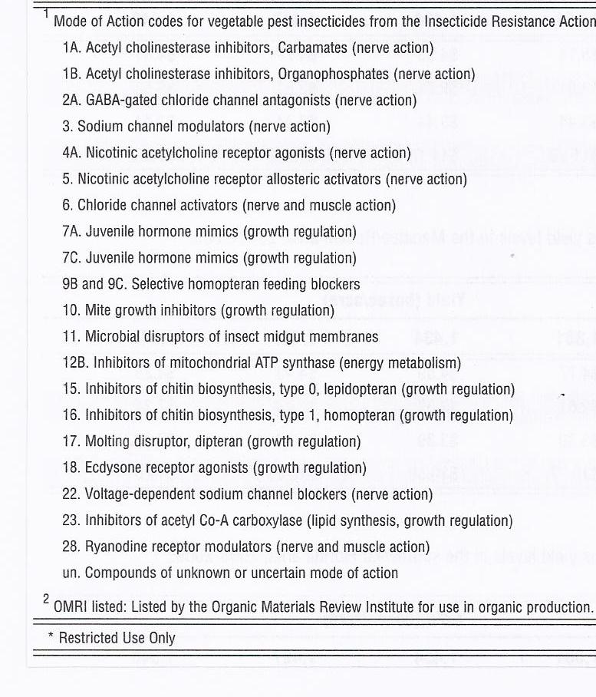
From Vegetable Production Handbook for Florida

Slide 22
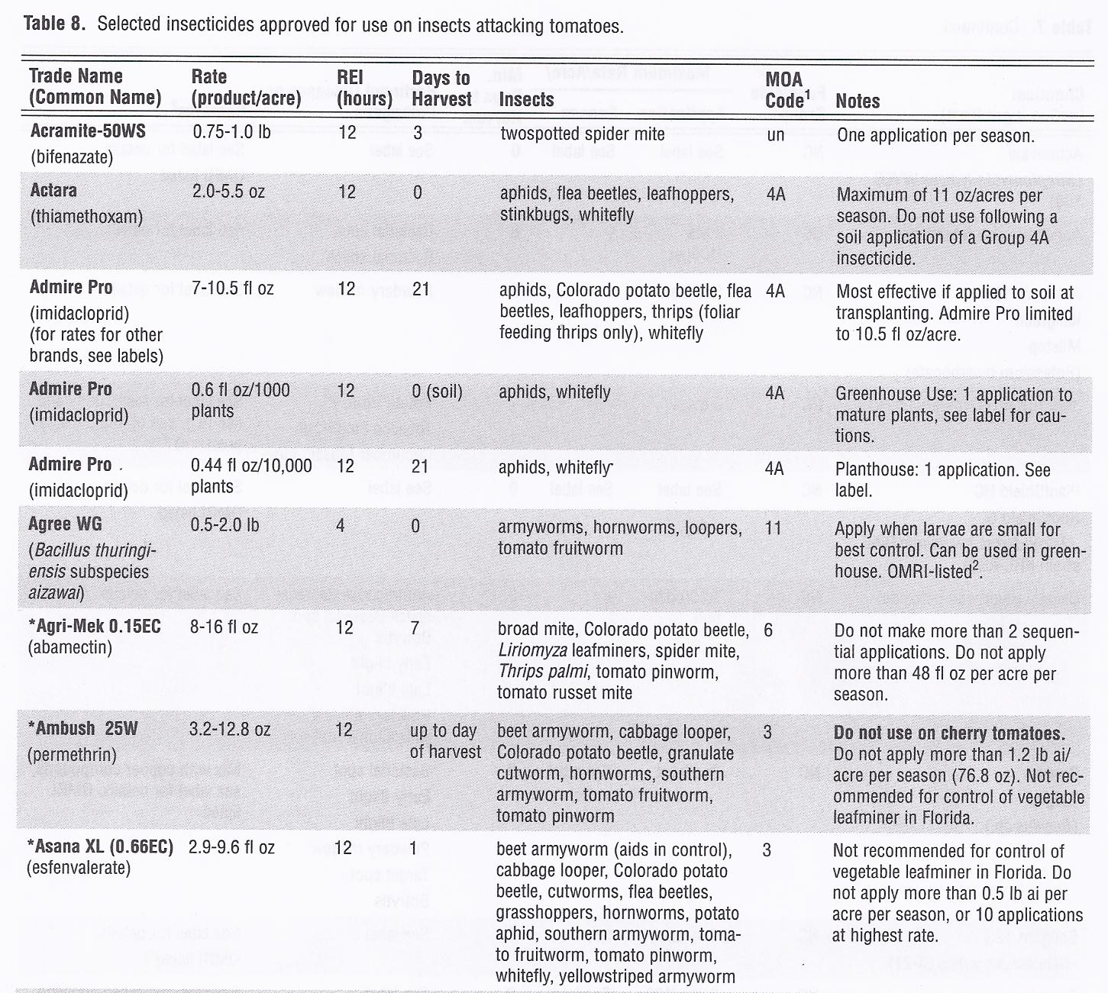

Slide 23
Whitefly Insecticides |  | Examples | IRAC # | Active ingredient
Nerve /Muscle poisons
Contact | Carbamate | Vydate | 1A |  | Restricted
 | OP | Monitor | 1B |  | Restricted
 | Cyclodiene | Thionex | 1C | Until end 2014 | Restricted
 | Pyrethroid | Mustang | 2 |  | Restricted
Systemic | Neonicotinoids | Admire Provado | 4A | imidacloprid | Tolerance issues
 |  | Actara Platinum | 4A | thiamethoxam
 |  | Venom Scorpion | 4A | dinotefuran
 |  | Assail | 4A | acetamiprid
 | Diamides | Coragen, Verimark* | 28 | Rynaxypyr, Cyazypyr

Slide 24
Whitefly Insecticides |  | Examples | IRAC # | Active ingredient
Nerve /Muscle poisons
Feeding blocker |  | Fulfill | 9B | Pymetrozine
Growth /development regulators | Juvenile hormone mimics | Knack | 7A, 7D | Pyriproxifen
 | Chitin biosynthesis inhibitor | Courier | 16 | Buprofezin
 | Lipid biosynthesis inhibitor | Movento Oberon | 23 | Spirotetramat Spiromesifen
Unknown |  |  |  | Pyrifluquinazon*
Softer materials: Azadirachtin products
Beauvaria bassiana
Soaps, oils, botanicals

Slide 25
Insecticide Resistance Action Committee (IRAC)
Resistance is ‘a heritable change in the sensitivity of a pest population,
reflected in the repeated failure of a product to achieve the expected level of control
when used as instructed for that pest species’.

Slide 26
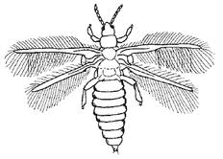
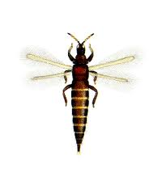
Development of Resistance
Susceptible Tolerant
Spray 1
Spray 2
Spray 3

Slide 27
Resistance Management:
Rotate modes of action.
Avoid exposing sequential generations of a pest to the same mode of action.

Slide 28

Evaluating insecticides that are nearing registration
Insecticide | IRAC MOA | Manufacturer | Registration
Sivanto | 4A | Bayer | 2013
Cyazypyr | 28 | DuPont | 2013
Pyrifluquinazon | Unk. | Nichino America | 2013
Sulfoxaflor | 4C | Dow | 2013
Fulfill | 9B | Syngenta | registered
Hero | 2 | FMC | registered

Slide 32
Percent TYLCV in tomatoes exposed to viruliferous whitefly 3, 7 or 14 days after treatment with Sivanto, Cyazypyr, Fulfill, Hero Pyrifluquinazon, and Sulfoxaflor.

Slide 33
GREEN ACRES 1997: BARRIER AND WIND DIRECTION. STRIP SPLIT PLOT.
RELEASE POINT
BARRIER
OPEN
BEAN
WIND

Slide 34
TRAP PATTERN, GREEN ACRES 1997
15.25 m
30.5 m

Slide 35
Adults/trap
Release 1

Slide 36
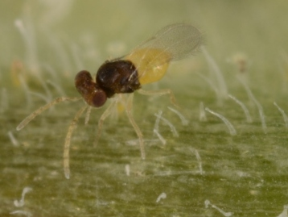
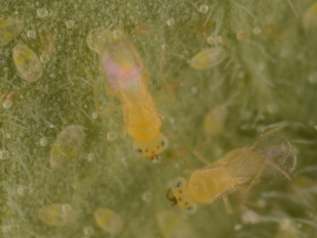
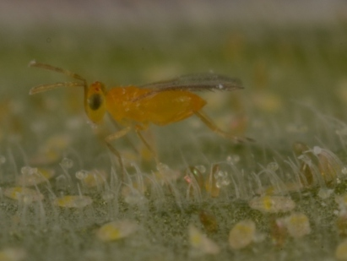
Whitefly parasitoids Photos: Lyle Buss
Encarsia formosa
Eretmocerus eremicus
Eretmocerus mundus

Slide 37
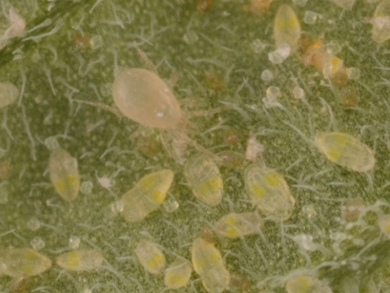
Amblyseius swirskii – whitefly predator Photo: Lyle Buss

Slide 38
There is a limited role for biological control in the management of virus vectors in field crops in Florida, particularly if the virus is persistently transmitted.

Slide 39
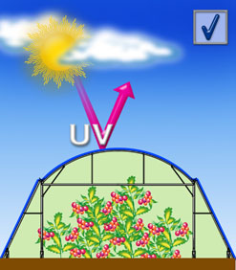
UV blocking shade cloth for greenhouses:
Reduces establishment of whiteflies, aphids, thrips and their viruses.
www.ginegar.com

Slide 40
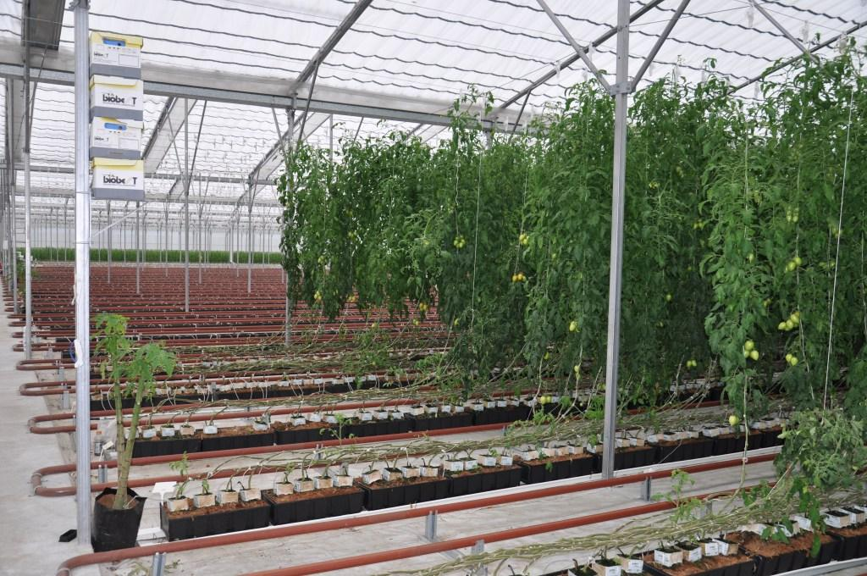
Screen house tomato production Florida
▪ Bumblebee pollinators
and papaya whitefly banker plant
▪ Indeterminate Roma tomato

Slide 41
Management of silverleaf whitefly and TYLCV in conventional field production
▪ Reduce inoculum: destroy residues from previous crops
▪ Use reflective plastic mulch on beds
▪ Use resistant varieties if possible
▪ Treat before planting with neonicotinoid
▪ Rotate adulticides, nymphicides and ovicides with different modes of action

Slide 42
Management of silverleaf whitefly and TYLCV in protected structures
▪ Use exclusionary material
▪ Use UV- absorbent material
▪ Use resistant tomato varieties when possible
▪ Biological control

